Slide 1
Terraform Onboarding
Client Solutions

Slide 2
Agenda
Introduction
Why are we doing this?
Plan
Architecture
Demo
11/22/2022
Terraform Onboarding

Slide 3
Introduction
Converting UI/manual creation and maintenance of PagerDuty resources (currently Users, Teams, Services, Escalation Policies and Schedules) into code-managed Terraform modules.
11/22/2022
PRESENTATION TITLE

Slide 4
Why are we doing this?
Allows squads to manage all the pager duty resources seamlessly.
Keeps uniform settings across the enterprise.
Easy recovery or reverting of changed or deleted resources
11/22/2022
PRESENTATION TITLE

Slide 5
Plan
1
2
3
4
5
Introduction & Demo(Today)
A basic demo of what it is?
Setup
Enable Client Solutions team members for the migration
Management
YAML files for Datadog/PagerDuty modules would altered with support of SRE
Review
PR would be created and shared for SRE review.
Apply
Post PR approval the changes would be applied via Terraform Web Console.
11/22/2022
PRESENTATION TITLE

Slide 6
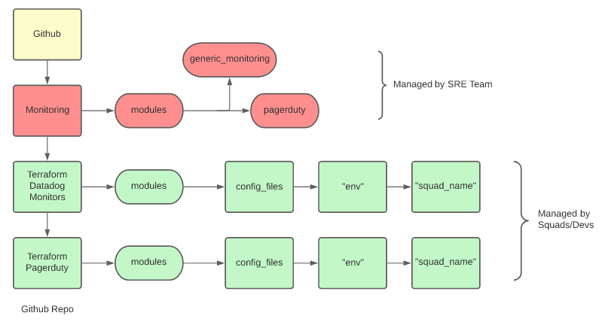
Architecture
11/22/2022
Terraform Onboarding

Slide 7
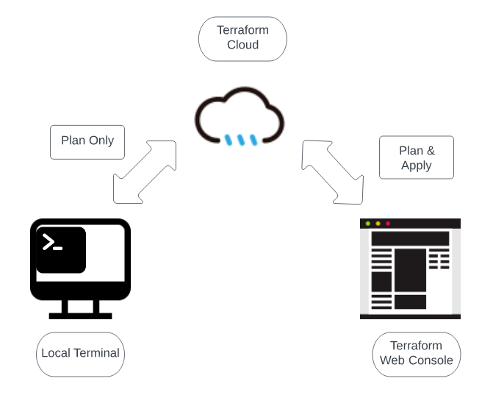
How it works
11/22/2022
Terraform Onboarding

Slide 8
Demo
11/22/2022
PRESENTATION TITLE

Slide 9
Thank you

